Slide 1
Socioeconomic Support as a Catalyst for Equitable Lung Cancer Care: Insights from Western Kenya
Authors: Catherine Ronoh- Oncology Clinical Officer Co-authors: Lawrence Atundo, Ruth Chebet,Madrine Wanja,Micah Odoyo.
Institutional affiliation: MTRH-AMPATH

Slide 2
INTRODUCTION
In low- and middle-income countries, lung cancer outcomes remain poor due to socioeconomic barriers that delay diagnosis and disrupt care continuity.
In Western Kenya, high transportation and diagnostic costs often delay care-seeking and treatment.
This study assesses the impact of socioeconomic support on lung cancer care engagement and continuity at MTRH.

Slide 3
METHODOLOGY
A retrospective analysis was conducted for patients enrolled in the Lung Program at MTRH from January to December 2024. The study included patients diagnosed with lung cancer who received financial support for services across the care cascade.
Support covered imaging, laboratory work-ups, immunohistochemistry (IHC), staging, and transport reimbursements for patients and caregivers.

Slide 4
METHODOLOGY CONT..
Support covered:
Imaging.
laboratory work-ups.
immunohistochemistry (IHC).
Staging.
Transport reimbursements for patients and caregivers.
Qualitative input from social workers provided contextual insights into patient experiences and barriers.

Slide 5
RESULTS
Among 56 patients diagnosed, 37 received imaging support, 26 laboratory work-ups, 33 transport reimbursements, 16 IHC and staging.
Care engagement and adherence were measured through attendance logs, completion of diagnostic milestones, and timeliness of treatment initiation.
Supported patients demonstrated higher completion rates of diagnostic procedures and consistent follow-up attendance compared to those without assistance.

Slide 6
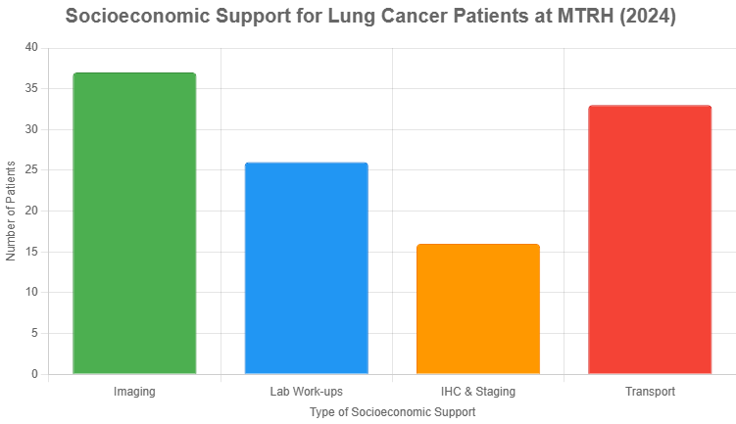
RESULTS CONT..

Slide 7
DISCUSSION
Socioeconomic support mitigated financial barriers, improving continuity of care and reducing delays in the diagnostic and treatment cascade.

Slide 8
CONCLUSION
Integrating socioeconomic support enhances equitable access and adherence to lung cancer care in resource-limited settings.
Scaling such initiatives can strengthen cancer care delivery and improve patient outcomes in Western Kenya.

Slide 9
KEYWORDS
Keywords Lung cancer, socio-economic support, Health equity, access to care, resource limited settings.

